Slide 1
WELCOME

Slide 2


Cloud Computing
Invented By
Andy Jassy (Officially launched in 2006)
Kuldeep Kokare (B.Tech Biotechnology)

Slide 3
CONTENTS
Introduction
Benefits of Cloud Computing
Types of cloud Computing
AWS Key Service Areas
Jobs for AWS Certified Professionals
Cloud Infrastructure Market Share

Slide 4
Introduction to AWS (Cloud Computing)
Amazon Web Services (AWS) is a comprehensive cloud computing platform provided by Amazon. It offers scalable solutions for compute, storage, databases, analytics, and more.
Cloud computing is Internet-based computing, whereby shared resources, software, and information are provided to computers and other devices on demand. Instead of buying, owning, and maintaining physical centers and servers, you can access technology services, such as computing power, storage, and databases, on an as-needed basis from a cloud provider like Amazon Web Services (AWS).

Slide 5




Benefits of cloud computing
Agility
The cloud gives you easy access to developing, testing rapidly, and launching applications that bring business growth in this fast and constantly changing IT environment.
Flexibility
With cloud computing, you have Flexibility to scale your IT resources up or down to meet sudden spikes in demand. You can scale these resources up or down to instantly grow and shrink capacity as your business needs change.
Cost savings
The cloud allows you to trade fixed expenses (such as data centers and physical servers) for variable expenses, and only pay for IT as you consume it.
Deploy globally
With the cloud, you can expand to new geographic regions and deploy globally in minutes. For example, AWS has infrastructure all over the world, so you can deploy your application in multiple physical locations with just a few clicks.

Slide 6




Types Of Cloud Computing
Infrastructure as a Service (IaaS)
IaaS is the basic building blocks for cloud IT. Provides access to networking features, computers and data storage space. Don't worry about IT staff, data centers and hardware.
Platform as a Service (PaaS)
PaaS provides a platform for developers to build, test, and deploy applications without the hassle of setting up and managing the underlying infrastructure.
Software as a Service (SaaS)
SaaS delivers software applications over the internet. Users can access and use these applications through a web browser without the need to install or manage the software locally.

Slide 7





Key service areas
Compute Storage Databases Networking Security
AWS offers a range of compute services, these services provide the processing power, memory to run your applications.
AWS storage services provide scalable, durable, and secure options for storing your data, whether it's files, databases, or backups. These services ensure your data is accessible when you need it.
AWS offers a variety of database services, these services make it easy to store and retrieve your application's data.
AWS networking services help you connect your resources, and deliver content to users. These services form the backbone of your infrastructure.
AWS is your guide in understanding and executing best practices to manage and reduce security
risk, and protect your networks and data.

Slide 8
Who can take AWS Certification
AWS Certification can be done by any IT professional (beginner or experienced) looking to give their career a jump or change their field.
Companies that provide AWS Certification course
Amazon Industries
TATA Consultancy Services,
Symbiosis,
Infosys
Wipro
They Charges around 40,000 - 60,000

Slide 9

Success Story
Name : Suryaji Vilas Ingavle
Education : BCA
Certification done from : Fortune Cloud
Company name : Capgemini
Role in company : Software associate
Package : 3 LPA

Slide 10
Jobs for AWS Certified Professionals & there Salaries/Anum
Cloud Architect (1,40,000 - 2,00,000)
Cloud Engineer (4,75,000 - 7,50,000)
Cloud Security Engineer (4,50,000 - 10,50,000)
Cloud Developer (6,50,000 - 17,00,000)
Network Engineer (5,50,000)

Slide 11
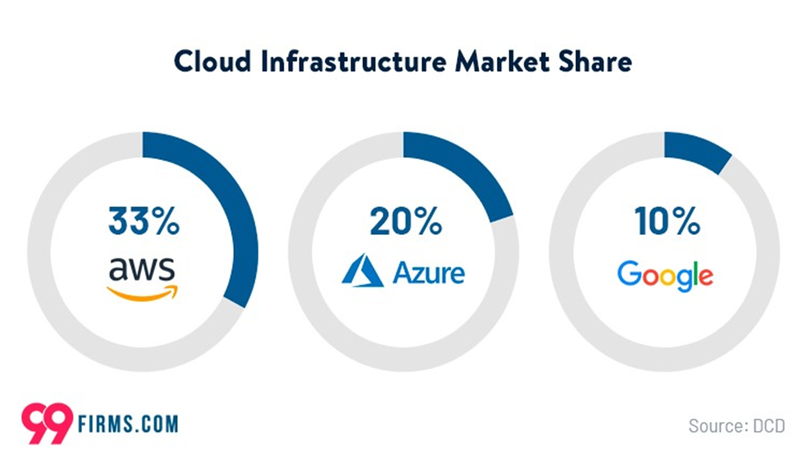
Jobs in the Market (using graphs and comparing to other technologies)
Now in 2024, AWS maintains its stronghold in the cloud market, capturing a significant share of the global cloud computing revenue. With an estimated market share of over 33%, AWS continues to outpace its competitors, solidifying its position as the leading cloud service provider worldwide.

Slide 12
Thank You

